Slide 1
Advanced spreadsheets
Lesson 4: Logical operators and the REPT function

Slide 2
Objectives
In this lesson, you will learn how to:
use the logical operators AND and OR when writing IF functions
use the REPT function to repeat characters in a cell.

Slide 3
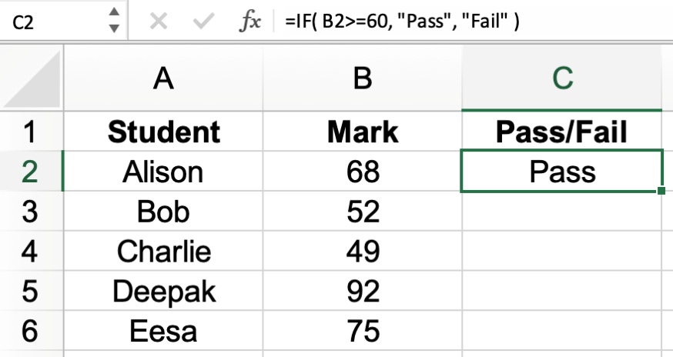
IF functions: a reminder
So far, we have used IF functions to check if a single condition has been met.
For example: =IF( B2>60, "Pass", "Fail" )

Slide 4
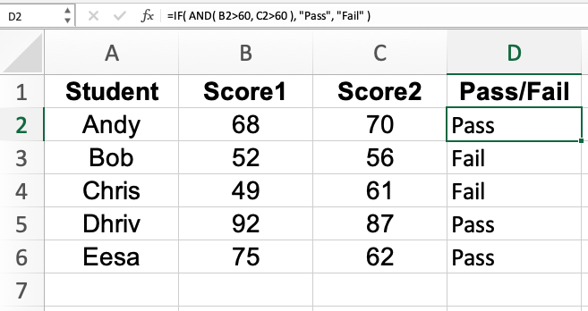
Using AND in an IF function
We can include the logical operator AND in an IF function to check that more than one condition is True.
For example: =IF( AND( B2>60, C2>60 ), "Pass", "Fail" )
Now watch Video 4.1
This IF function requires both the value in cell B2 and the value in cell C2 to be greater than 60 for the student to achieve a pass.

Slide 5

Activity 4.1: Competition

Slide 6
Activity 4.2: Maths sets

Slide 7
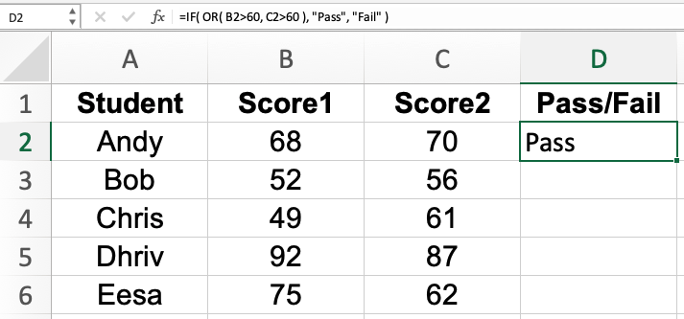
Using OR in an IF function
If we want one or more conditions to be met, we can use the OR operator in an IF function.
For example: =IF( OR( B2>60, C2>60 ), "Pass", "Fail" )
This IF function requires the value in cell B2 or the value in cell C2 to be greater than 60 for the student to achieve a pass.

Slide 8
Activity 4.3: Competition 2

Slide 9
Activity 4.4: Stock levels

Slide 10
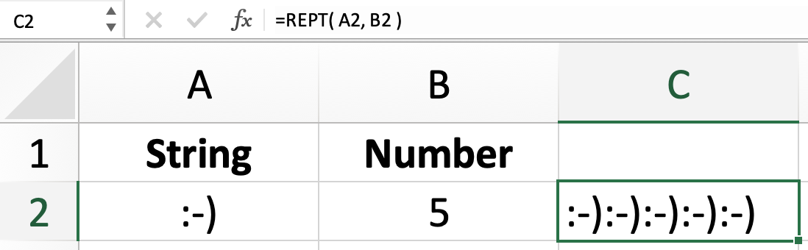
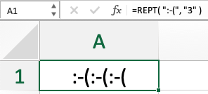
The REPT function
The REPT function is used to repeat a string of characters a given number of times:
=REPT( text, number of times )
In this example, the text in cell A2 is repeated the number of times specified in cell B2.
You can also use the REPT function without cell references:
Now watch Video 4.2

Slide 11
Activity 4.5: Homework

Slide 12
Quiz 4

